Slide 1
Engaging with Digital Research 2015 Week 1 The Use of Research and Evidence
MUDR
James Stewart

Slide 2
Course Themes and Outline
Understand and critically engage with the legitimisation, development and integration of ‘digital’ research and evidence in to practice
Use perspective –
The use of research and evidence, and the role of research in production of evidence
Use the example of metrics and indicators in the field of science and scholarship.
Allow us to explore other fields.

Slide 3
Course Outline
Week 1: Explore the Use of Research and Evidence in practice, to develop a conceptual foundation for understand the use of digital research
Week 2: Example of the use of research – metrics, indicators and ranking
Scope of digital metrics, indicators and ranking
The case of metric and ranking in Science
Use and mis -use of indicators and rankings

Slide 4
Cont.
Week 3: Innovation in the production and use of ‘digital’ research and evidence
Legitimisation of digital metrics and indicators
Social learning and innovation processes
Develop of a sustainable business/service
Example of Alt-metrics in science
Week 4: Tutorial on the COSMOS social media analysis tool
Week 5: Pair work on digital evidence and indicators in practice: Presentation

Slide 5
Assessment
Study Session assessment Week 1 on use of research and Evidence 20%, 3 questions
Pair Presentation: 30%, Week 5
1. A case of the development of the use practice and/or business based on digital research and indicators (e.g. film funding, twitter storm; learning analytics, google analytics, Referendum; telehealth)
2. Propose the use of alt-metics as (part) of an indicator in a policy or business context, and argue what research and other work is needed to legitimatise the indicator.
Personal Essay : 50 %
On Any topics raised in the Course.

Slide 6
Questions?

Slide 7
What is ‘Digital Research’ ?

Slide 8
TV phone Polls
Internet Panels
Social media
Rating sites
Admin data from organisations
Ethnography, online, mobile, video etc
Scraping bulletin boards etc
Crowdsourcing data and analysis
Participatory research
Machine sensor networks - centralised and decentralised
System, network Logs - Analytics
Satellite images
Computer Modelling
Large scale Multi-data set models and ranking
Mashup of multiple datasets
Interactive simulations and games

Slide 9
Use of research and Evidence in policy/management

Slide 10
Use of Research
From Reading: Social and political process
“Knowledge Utilisation” has a long history
Many ways to explore use of Research:
E.g. (Weiss, UNESCO)
Characteristics of the research and the researchers who conduct it
Characteristics of modes of dissemination or linkage between researchers and the policy arena
Characteristics of potential user groups
Characteristics of the political domain that the research enters

Slide 11
Carol Weiss 1979
(1) The knowledge-driven model
(2) The problem-solving model
(3) The interactive model
(4) The political model
(5) The tactical model
(6) The enlightenment model
(7) Research as part of the intellectual enterprise of society
How is research used in your field?
Reflection: 2 examples of different uses of research and evidence you are familiar with (provide links, documents etc),
For later: Why is Digital Research being commissioned or considered?

Slide 12
Question
What is missing from Weiss, and Nutley et al?

Slide 13
What does Research produce:
Knowledge?
Engagement?
Evidence?

Slide 14
Evidence

Slide 19
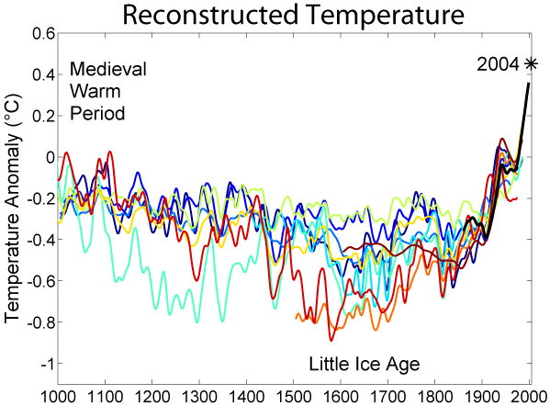

Slide 20
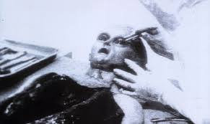

Slide 21
Common forms of evidence
Polls
RCTs
Official statistics
User research
Administrative data
Prospective studies
Detailed case study
Computer model
Competitor information
Expert knowledge
Sales figures
Military Intelligence
Technical tests
Guilty face and sticky fingers
Blush

Slide 22
OED Definition
1. The available body of facts or information indicating whether a belief or proposition is true or valid.
2. Information drawn from personal testimony, a document, or a material object, used to establish facts in a legal investigation or admissible as testimony in a law court.

Slide 23
Examples of evidence
An object
A statement
An observation
First hand accounts –text, video, recording
Stories and Narratives
Quantitative data
Comparison
Accepted knowledge
Logical argument
Analogies
Theory-backed proof
A model
Money
Visualisation
Interactive simulation or model
Indicators of something in the world

Slide 24
Use Evidence
Resource for decision making
In law, everyday life, design, business, policy
Punctual use
Continual use
To reduce uncertainty,
To shape opinion
Legitimise a decision, or lack of decision
Handle contested issues
“How does evidence speak to Power”

Slide 25
A social process and practice
Evidence is provided at the right time and in the right place and in a form that can be used by those making decisions, with legimating support
Legitimate evidence
Experts and expertise
Method
Tradition
Scientists, business people, politicians, policy makers, mangers, individuals
(Sociology of Science Knowledge)

Slide 26
Normative, empiricist approach
It is wrong always, everywhere, and for anyone to believe anything upon insufficient evidence
W. K. Clifford (1879)
Evidence-based
Natural Philosophy=Science
Policy
Management
Personal decision making
Medicine
etc

Slide 27
Make Evident
Obvious
Incontestable

Slide 28
How to make something evident
Visualisation
Comparison, Trend,
Narrative
Chain of hypotheses
Emotive
Witness, visualisation
Theory
Scientifically proven hypotheses
Statistical tests
Experts and other respected agents make evidence legitimate e.g. Scientist, Accountant, BBC, Government Minister

Slide 29
Failures of evidence processes
Costs – evidence is expensive
Expertise scarce
Legitimising agents and processes can fail or lose power
Misuse – evidence is used without critical examination

Slide 30
Evidence in the Digital Age
New Visualisations (interactive, scalable etc)
Data collection at scale
‘Big Data’ methods
Easily accessed administrative data
Open Data
System logs
Computational models
Distributed collection and analysis (crowd)

Slide 31
Evidence from research
Research derived evidence
cf. Experts, stakeholders, public consultation
(though this can be transformed through research)
Research improves the ‘qualities’ of evidence
But what are those qualities?
How do these qualities make evidence legitimate?

Slide 32
Hierarchies of evidence based on research method
Systematic reviews and meta-analyses
Randomised controlled trials with definitive results
Randomised controlled trials with non-definitive results
Cohort studies
Case-control studies
Cross sectional surveys
Case reports
An example of the “hierarchy of evidence (M Petticrew, H Roberts2 2002) http://jech.bmj.com/content/57/7/527

Slide 33
Petticrew &Roberts (2002)
The concept of a “hierarchy of evidence” is often problematic when appraising the evidence for social or public health interventions.
The promotion of typologies rather than hierarchies may be more useful than hierarchies in conceptualising the strengths and weaknesses of different methodological approaches
A matrix based approach, which emphasises the need to match research questions to specific types of research may prove more useful”
Realist Perspective – (e.g. Pawson)

Slide 34
How is/could be digital research made legitimate, in your field of experience?
Who commissions produces and who uses
When – e.g. Timeliness,?
What ways can it be used (Weiss)
How much does it cost?
Legitimising agents
Legitimising processes
etc

Slide 35
Next
Do the Assessment
Find examples of digital-based indicators and metrics in common use
Find examples of use of (any) metrics and indicators in your field, and how they are produce and used
Read 2 papers on science metrics – one on practice, and the other on Google as alternative ranking tool.
I have provide some questions for group discussion during the week.

