Slide 1
The production and impacts of Metrics and Indicators
Engaging with Digital Research
Week 2
MUDR 2015
James Stewart

Slide 2
What is Digital Research?

Slide 3
TV phone Polls
Internet Panels
Social media
Rating sites
Admin data from organisations
Ethnography, online, mobile, video etc
Scraping bulletin boards etc
Crowdsourcing data and analysis
Participatory research
Machine sensor networks - centralised and decentralised
System, network Logs - Analytics
Satellite images
Computer Modelling
Large scale Multi-data set models and ranking
Mashup of multiple datasets
Interactive simulations and games

Slide 4
Comments on readings, ideas from Week 1
Use of Research?
Evidence?
Assessment

Slide 5
What is a metric?

Slide 6
What is an Indicator?
How does it indicate?
i.e. What is needed to make a legitimate and credible indicator?

Slide 7
Uses?
A form of evidence
Assessing Quality – e.g. reputation
Ranking and Benchmarking
Informing decisions about the future
Assessing the past
Communication and engagement
To drive matching algorithms
Etc….

Slide 8
Comments on the case of science
What shapes the creation of impact metrics?
How does this lead to ranking?
What is the use of ranking?
What is the impact of this use?
How has Google Scholar challenged the existing impact ranking processes?

Slide 9
How are metrics and indicators used in practice?
Can you other examples? Discuss their validity.

Slide 10
Digital indicators and ranking
Identify some 'digital' sources that are or are used as metrics or indicators (e.g. open data, social media, machine sensors etc), and the rankings or ratings built on them?
What novel data collection instruments?
What novel analysis methods?
What novel visualisations?

Slide 15
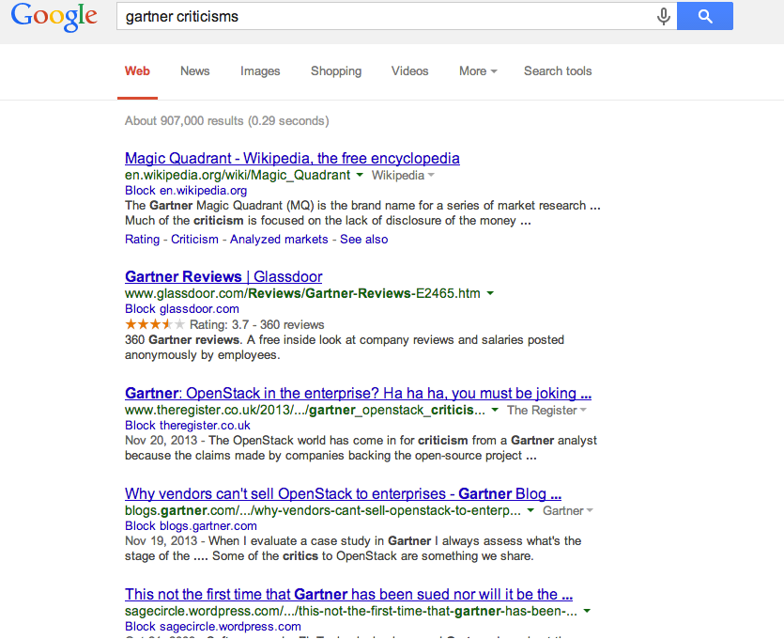

Slide 16
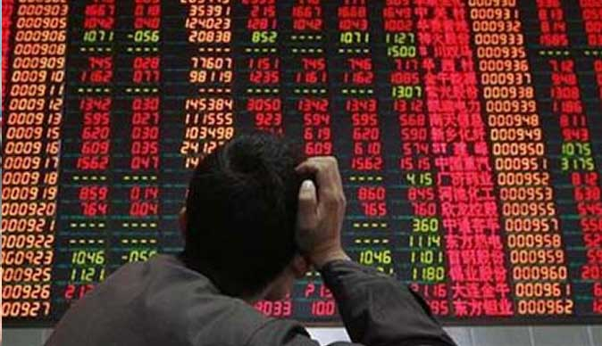

Slide 20
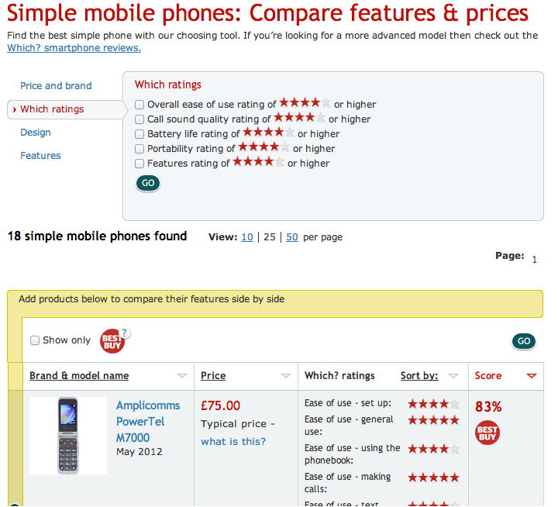

Slide 21
Sources of digital indicators
Crowdsourced
Formalised (Trip advisor, Uber, Amazon, ebay, Facebook likes)
Informal (e.g. mining tweets, Google searches)
From ‘curated’ sources
Dating websites
Price comparison
Sensors
Traffic : data, vehicles, people, goods
From established datasets
etc

Slide 22
Indicators of Qualities in Uncertainty
Engineering tests: to specification, within tolerance, measurement of performance against pre-established criteria
Market test – most popular, best performing…
Firms’ future – share price, analyst recommendations
Countries – credit rating
Multiple sources: Tests, data collection, analysis.
Multi-dimensional space
Who sets the indicators – how are they decided, how are they actually calculated, what are the weightings, what data are they based on?

Slide 23
Policy Indicators
Did you Read Economist article?

Slide 24
Example policy indicators
Society
•Human Development Index (United Nations)
•Health System Achievement Index (WHO)
•Corruption Perceptions Index (Transparency International)
•World Income Inequality Database:Gini Index (United Nations)
•Wellbeing Index (Prescott-Allen)
•Genuine Progress Indicator (Redefining Progress)

Slide 25
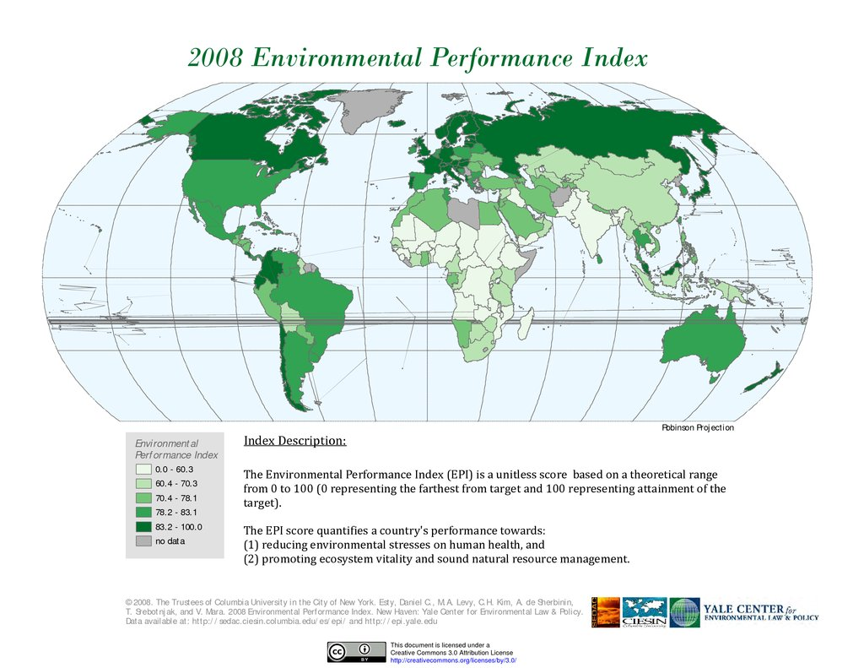

Slide 26
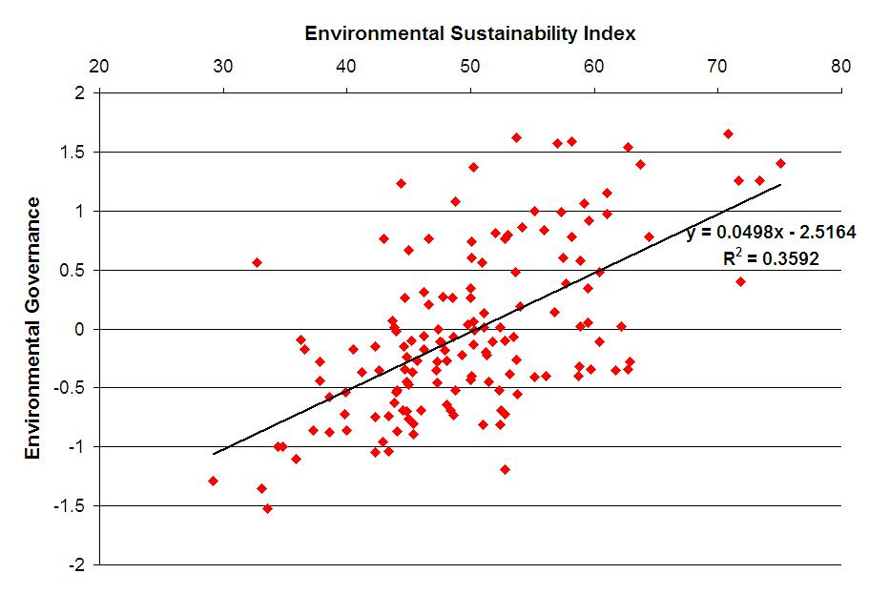

Slide 27
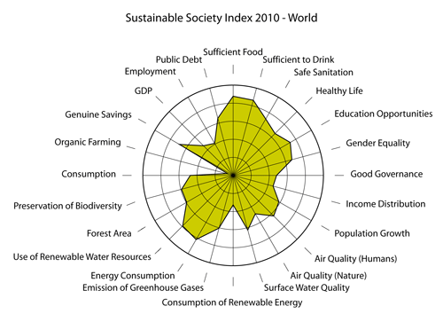

Slide 28
Composite indicators
Technical definition:
Composite indicators are mathematical combinations (or aggregations) of a set of indicators.
Conceptual definition:
“Composite indicators are based on sub-indicators that have no common meaningful unit of measurement and there is no obvious way of weighting these sub-indicators”
(Source: Note on composite indicators, EC, Brussels, March 2002)
Notes:
Ref: http://www.oecd.org/sti/ind/29398640.pdf JCR and OECD

Slide 29
Composite indicators in policy
To summarise complex or multi-dimensional issues.
To place countries’ performance at the centre of the policy arena.
To offer a rounded assessment of countries’ performance.
To enable judgments to be made on countries’ efficiency.
To facilitate communication with ordinary citizens.
To be used for benchmarking countries of best performance.
To indicate which countries represent the priority for improvement efforts.
To stimulate the search for better data and better analytical efforts.
To set local priorities, and to seek out improvements along dimension of performance where gains are most readily secured.
Source: Michaela Saisana, JRC 2004

Slide 30
What other uses?

Slide 31
Negative aspects
May send misleading, non-robust policy messages.
May invite stakeholders to draw simplistic conclusions.
Involve judgmental decisions
Increase the quantity of data needed.
May disguise serious failings in some parts of some systems.
May rely on very feeble data in some dimensions.
May ignore dimensions of performance that are not measurable

Slide 32
Should be:
“simplistic presentations and comparisons of performance in given areas to be used as starting points for further analysis and discussion”
But: “a single number of dubious significance”
Stakeholders tempted to summarise complex (elusive) processes into a single figure to benchmark country performance for policy consumption
Composite indicators are powerful tools to shape perceptions and actions
Notes:
http://www.oecd.org/sti/ind/29398640.pdf

Slide 33
Visualisation is important

Slide 34
Common indicators and ranking in business
Market and ‘nature’ driven:
Stock market valuation
Crop Yields
Analyst created
The Boston Matrix
The Gartner Magic Quadrant
Inflation rate
Consumer confidence indicator
Long Range weather forecast

Slide 35
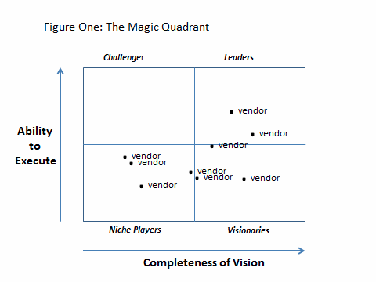

Slide 36
Other domains
Arts and entertainment
Public Heath
Environment
Political prediction
Online labour markets
……

Slide 37
Reflect on Indicators in Policy in Scotland

Slide 38
e.g.”Improve the Quality of Healthcare Experience”
Indicator is based on the reported experience from hospital inpatients as a proxy for experience across the NHS
The data are collected by approved contractors using centrally determined methodology. The overall number of surveys returned in 2013/14 was 21,127. The sample was stratified by hospital so that site level (and in some areas sub-site) estimates could be calculated. Scotland results are calculated by weighting the strata results by number of patients.
The indicator is calculated by taking the mean scores for individual patients' answers to the following questions in the inpatient survey and weighting them using total inpatient numbers to get a national score:
Overall, how would you rate your admission to hospital (i.e. the period after you arrived at hospital but before you were taken to the ward)?
Overall, how would you rate the care and treatment you received during your time in the Emergency Department / Accident and Emergency?
Overall, how would you rate the hospital environment?
Overall, how would you rate your care and treatment during your stay in hospital?
Overall, how would you rate all the staff who you came into contact with?
Overall, how would you rate the arrangements made for you leaving hospital?
`

Slide 39
SCOTLAND PERFORMS - 10 GUIDING PRINCIPLES
Openness and transparency
Accountability and responsibility
Objectivity
Independent assessment
Dynamic site: real data, real time
Accessibility 24/7
Simplicity and clarity
Credibility to Parliament and the wider public
Shared responsibility for outcomes-based performance (with our partners)
Sharpening focus - driving improvement
http://www.gov.scot/About/Performance/scotPerforms/NPFChanges/Methodology

Slide 40
Use and creation of indicators
How are indicators actually used?
What research is needed to show that a particular metric is valid or legitimate indicator?
E.g. compare to benchmarks, theory of causality, demonstrated correlation, sample measure, instrument reliability (e.g. Google flu, Oscar predictions etc)
How can new ‘Digital’ sources be used to complement, challenge or modify indicator?
According to the criteria? In practice?

Slide 41
Metrics and indicators in the Digital Age
Many links on the Wiki – please add and explore
Week 3 – case of creating and institutionalising ‘altmetrics’, and digital research in general
Assessment 2 - On the creation and legitimisation of digitally-sourced indicators and metrics.

