Slide 1
MOBILE TECHNOLOGIES
Benefits and Drawbacks

Slide 2
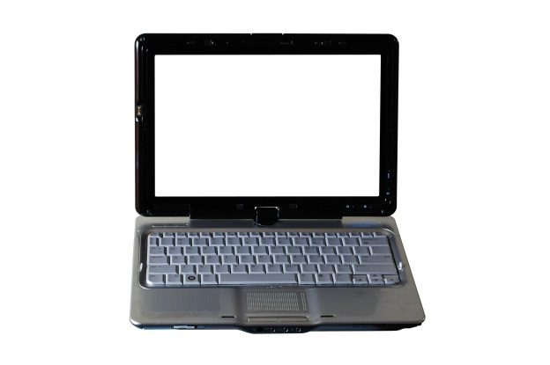
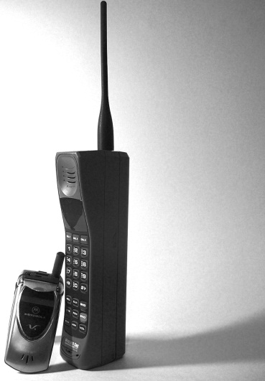
What is Mobile Technology
Basically mobile = portable
Click on the picture below for more definitions

Slide 3
Examples of Mobile Technology
Laptop computers
Palmtop Computers or Personal Digital Assistants (PDA’s)
Mobile Phones and 'smart phones' - high-end phones with more advanced capabilities
Global Positioning System (GPS) devices

Slide 4
Communication Technology
Wireless Fidelity (WiFi) - a type of wireless local area network technology.
Bluetooth - connects mobile devices wirelessly.
Third Generation' (3G), global system for mobile communications.
virtual private networks - secure access to a private network.

Slide 5
Benefits
Improved communication
Better and faster service you give to customers
Greater flexibility – access internal databases while off site
Able to access Internet anywhere
Send email on the move
Carry out banking transactions

Slide 6
Drawbacks
Initial cost
Dropped off calls during conferences
Training
Maintenance
Expose valuable data if lost
Poor or No Signals

Slide 7
Summary
Organisations that embrace mobility for business purposes likely will become not just more efficient, but also places where more people want to work.
http://www.strategicgrowthconcepts.com/growth/increase-productivity--profitability.html

Slide 8
References
http://www.ehow.com/info_7759298_disadvantages-mobile-phones-business.html
Images courtesy of http://www.sxc.hu/

