Slide 1
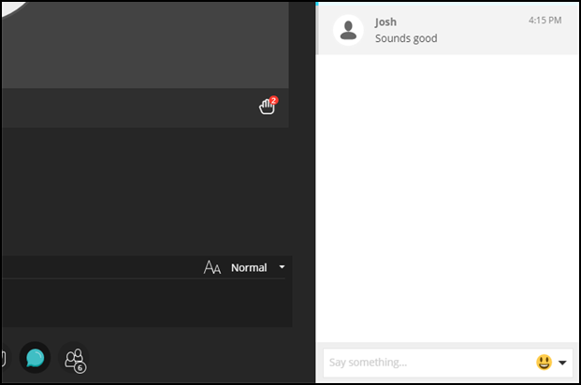
Audio check
Can you hear the presenter talking?
Please type yes or no in the “Text chat area”
www.ed.ac.uk
applyedinburgh

Slide 2
Asking questions
Always use the hand raise icon to queue up your question.
When called upon to ask your question, type a question in the “Text Chat Area”
www.ed.ac.uk
applyedinburgh

Slide 3
Recording
This session will now be recorded. Any further information that you provide during a session is optional and in doing so you give us consent to process this information.
These sessions will be stored by the University of Edinburgh for one year and published on our website during that time.
By taking part in a session you give us your consent to process any information you provide during it.
www.ed.ac.uk
applyedinburgh

