Slide 1
The production and impacts of Metrics and Indicators Part 1
Engaging with Digital Research
Week 2
MUDR 2017
James Stewart

Slide 2
What is a metric?
A measure
“Quantitative assessment used for measurement, comparison or to track performance or production

Slide 3
What is an Indicator?
How does it indicate?
i.e. What is needed to make a legitimate and credible indicator?

Slide 4
Uses?
A form of evidence
Assessing Quality – e.g. reputation
Ranking and Benchmarking
Informing decisions about the future
Assessing the past
Communication and engagement
To drive matching algorithms
Etc….

Slide 5
Reflect on the case of science
What shapes the creation of impact metrics?
How does this lead to ranking?
What is the use of ranking?
What is the impact of this use?
How has Google Scholar challenged the existing impact ranking processes?

Slide 6
Reflection
How are metrics and indicators used in practice?
Can you other examples? Discuss their validity.

Slide 7
Digital indicators and ranking
Identify some 'digital' sources that are or are used as metrics or indicators (e.g. open data, social media, machine sensors etc), and the rankings or ratings built on them?
What novel data collection instruments?
What novel analysis methods?
What novel visualisations?

Slide 12
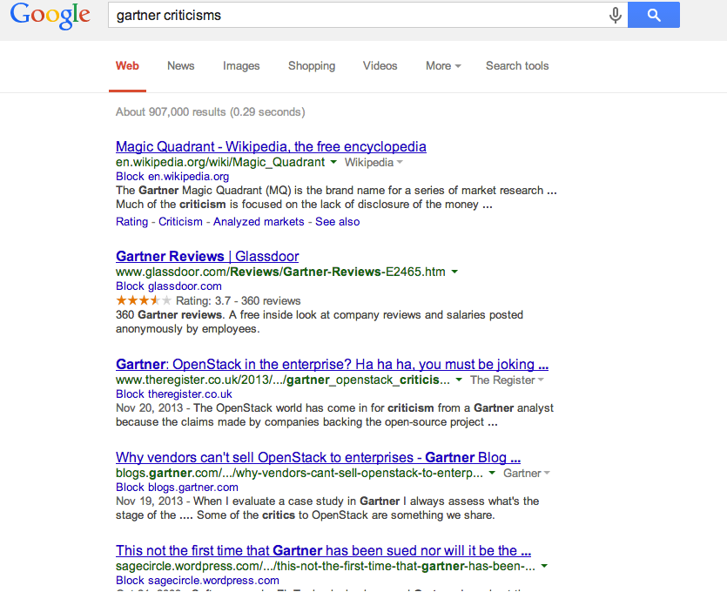

Slide 13
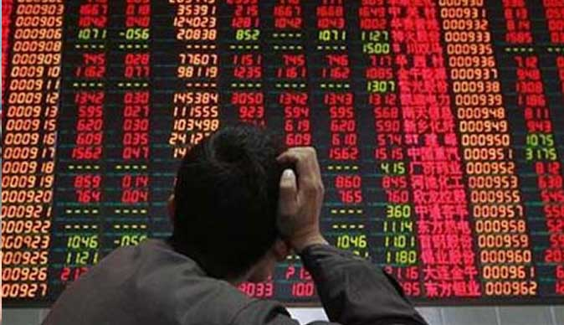

Slide 15
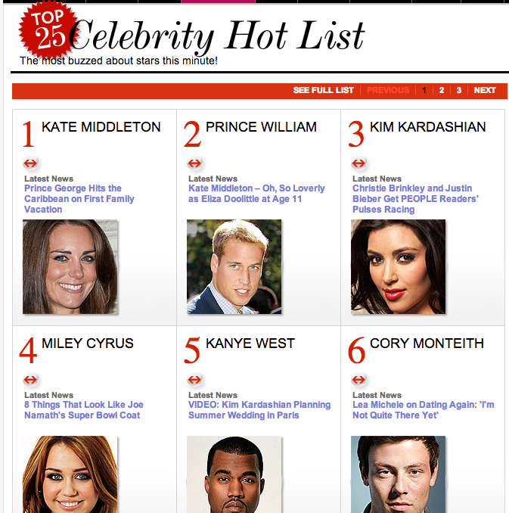

Slide 17
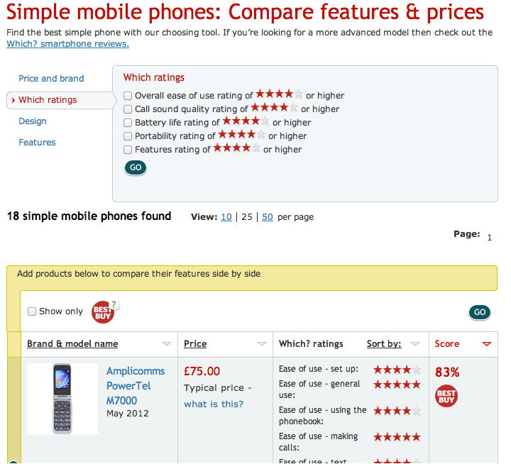

Slide 18
Sources of digital indicators
Crowdsourced
Formalised (Trip advisor, Uber, Amazon, ebay, Facebook likes etc)
Informal (e.g. mining tweets, Google searches)
From ‘curated’ sources
Dating websites
Price comparison
Sensors
Traffic : data, vehicles, people, goods
From established datasets
etc

